Slide 1
Why Julia is the most suitable language for science
…and how we use it in JuliaDynamics
Notes:
Ph.D. student, Physics: “electron transport”, classical & quantum

Slide 2
TL;DR: Julia = “most” suitable for science
My own opinions
What does most mean? (there is no “best”)
Most developer-friendly…
Most “share-able”…
Most performant…
…most of the time
Yes, I am aware that some features exist in other languages

Slide 3
What does science need from code?
Performance of “doing science” , solving your problem
Interactive Language
Performance of computation
Source code that is concise, intuitive, easy to read & understand
Code that is easy to share, install, use and replicate
Free and open sourced (collaborate with anyone)
Notes:
So when I have a scientific question I want to solve using simulations:
Understand how the problem can be solved using the computer language
Implement your idea in this programming language
Let the code run and get your results
Read and visualize your results, using the same language if possible
Understand they are nonsense so go back and debug
Run code again and get your final and correct results.
This is a recurring theme: more and more people keep pointing out how important is development speed.

Slide 4
What we all know and love
Julia is advertised as
Dynamic language
Intuitive syntax
Free & Open sourced
Performance as good as C/Fortran
Solves the two language problem!
“Feels like Python; works like Lisp; fast like C”
Hypermassive benefit for science!!!
What Julia Offers Academic Researchers by Nick Eubank
Notes:
I am assuming that everyone that will hear my talk already knows about this facts. If you see this list for the first time, maybe it is best to first see a more “introductory” level talk, one example is this great talk by Nick Eubank, which you can find on youtube.

Slide 5
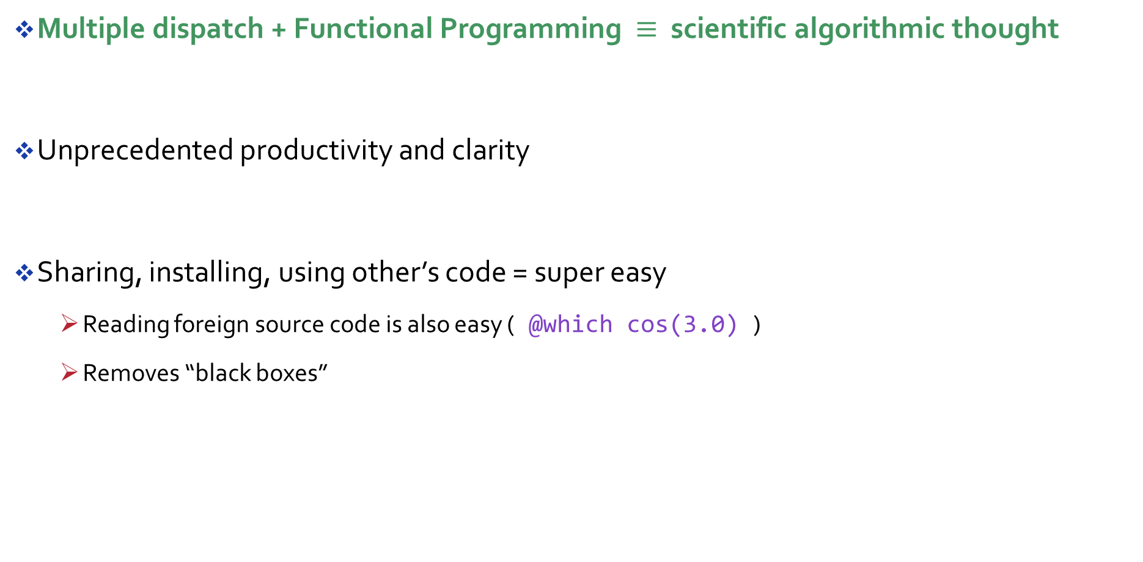
This talk: “unspoken” powers of Julia
Multiple dispatch + Functional Programming $≡$ scientific algorithmic thought
Unprecedented productivity and clarity
Sharing, installing, using other’s code = super easy
Reading foreign source code is also easy ( @which cos(3.0) )
Removes “black boxes”
Notes:
Point out that almost all Julia is written in Julia, and it is so super easy to understand almost all of Base as well!

Slide 6
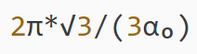
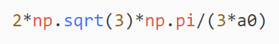

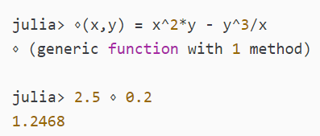
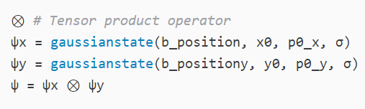
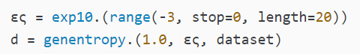
Syntax: clarity through the roof
Unicode:
Custom infix operators
Broadcasting (dot-fusion)
Python example, you could use α

Slide 7

Design: unlimited power productivity
Assignment returns value! (Hydrogen+Python vs Juno)
Functions that mutate end with !

Slide 8
Robust & reproducible science
The “Project” set-up is excellent for science:
Simply `] add Package` and is added to your project and dependency list
Send your colleague the “Project” and they do `] instantiate`
Since Julia is Julia, I imagine that almost all code will be trivial to install
Possibility of having different package versions for different projects
Robust implementation of missing that works all “major” types and is safe!
Notes:
Here “project” stands for your source code, the Project.toml and the Manifest.toml

Slide 9
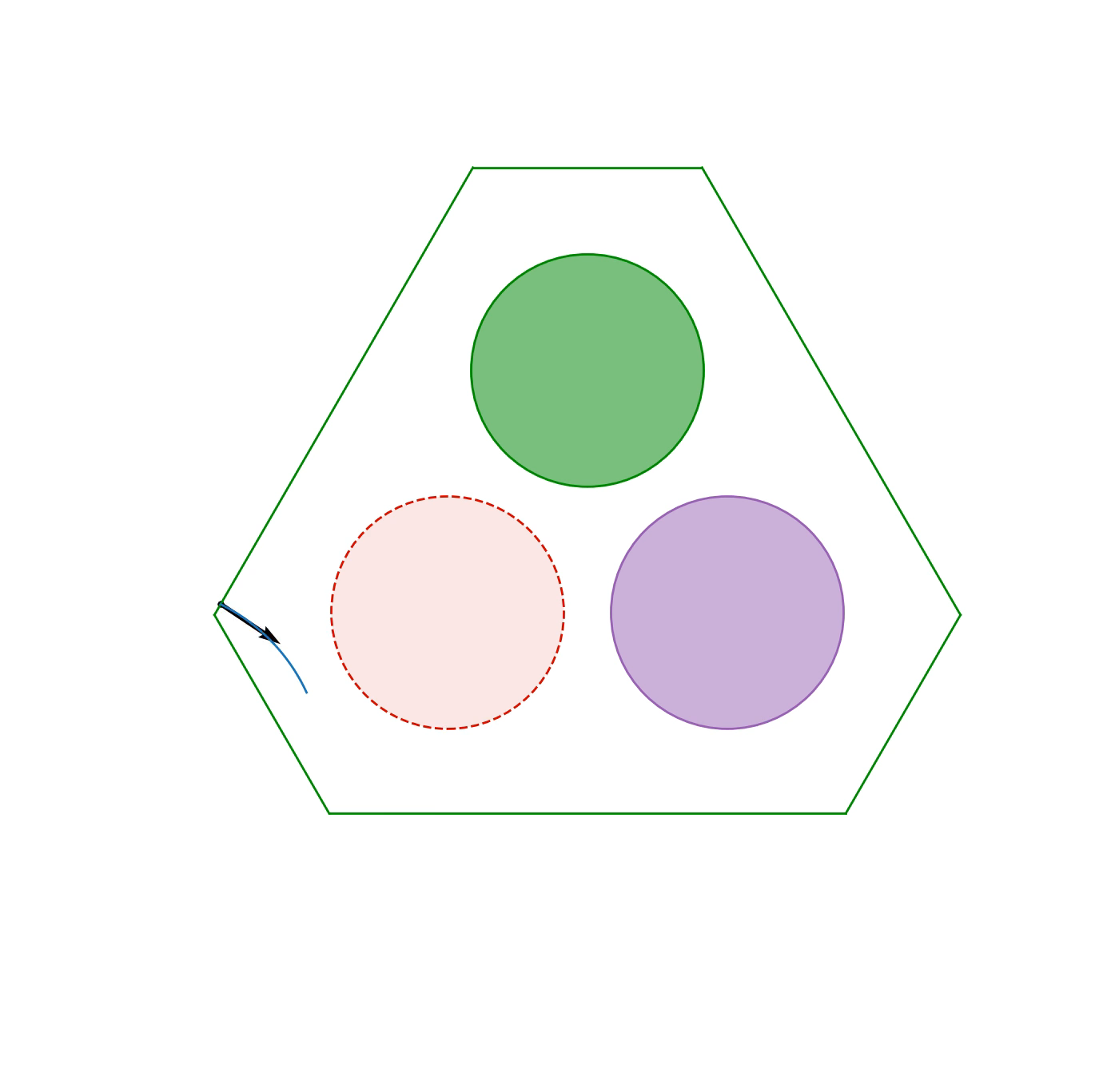
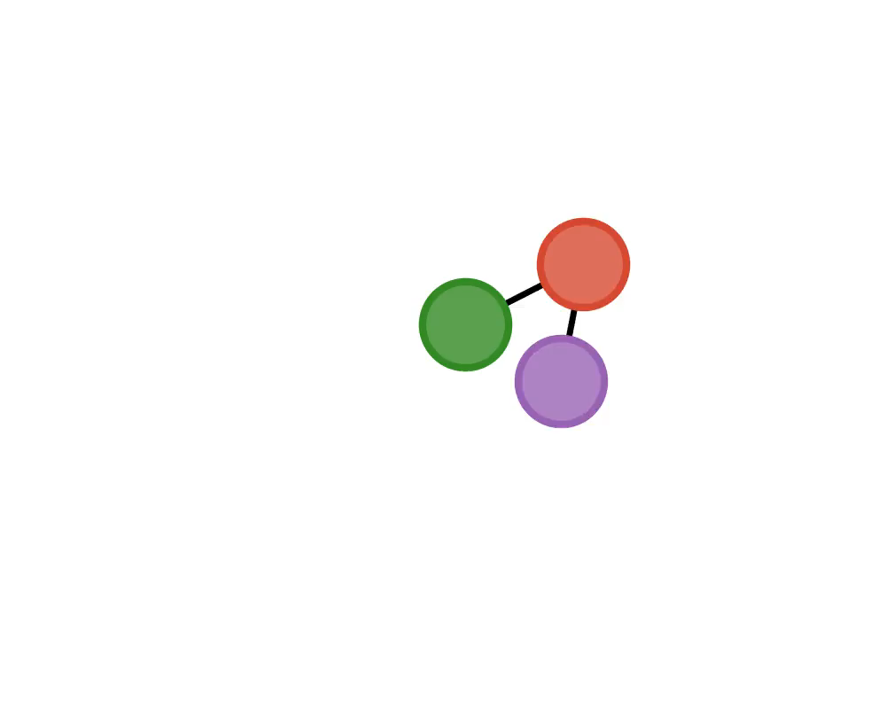
JuliaDynamics
github.com/JuliaDynamics
five aspects that highlight using Julia in scientific computing
Notes:
We now move to the second part of my talk. I want to introduce the GitHub organization JuliaDynamics. It constitutes of several Julia packages, some of which I will highlight. Through them, I will also show five aspects that highlight…

Slide 10
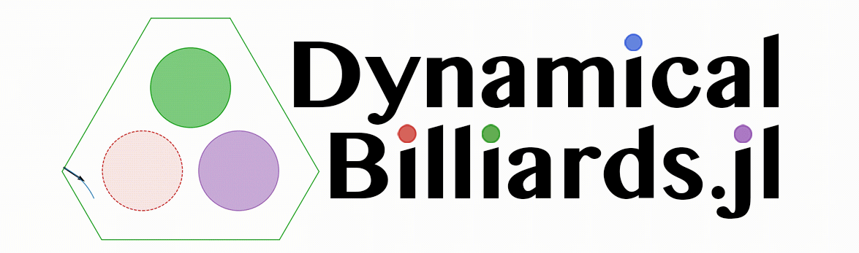
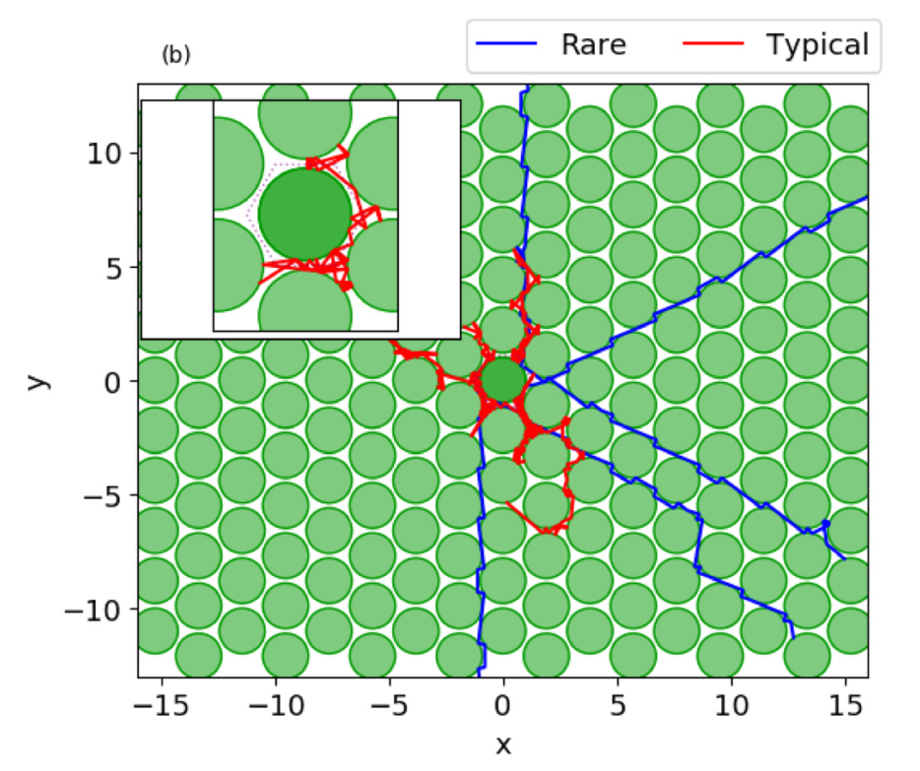

DynamicalBilliards.jl
Billiard: particle propagating in a domain, bouncing from obstacle to obstacle
Already used in research:
Notes:
So billiard systems are very interesting and have been used in science for a long time, to simulate all kinds of systems from gases all the way to nanodevices.

Slide 11
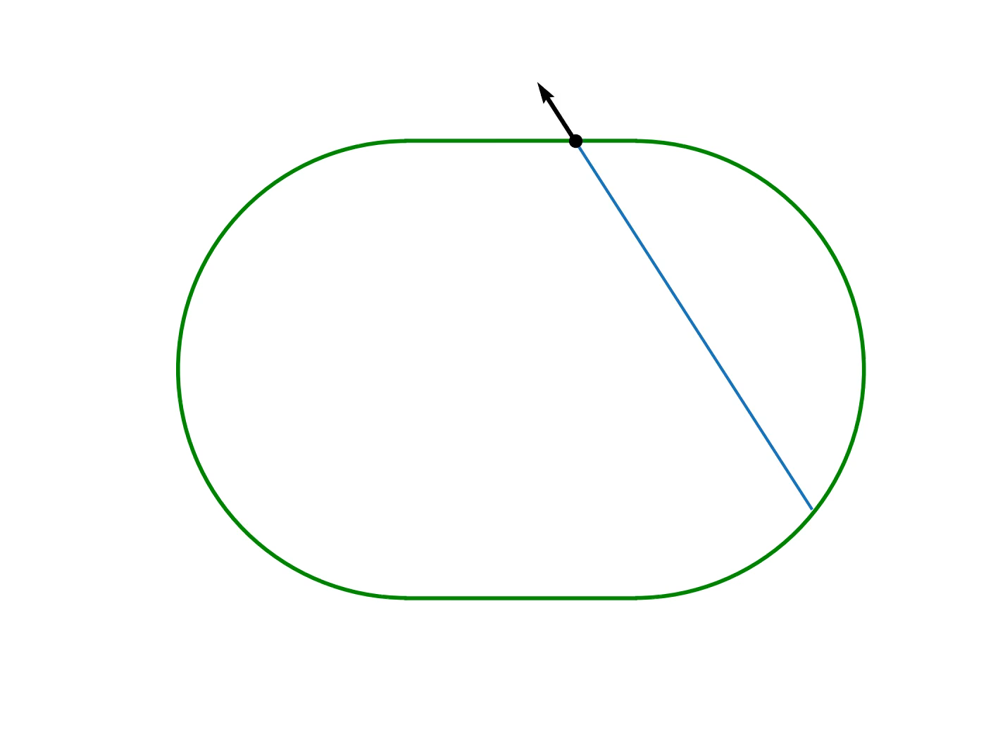
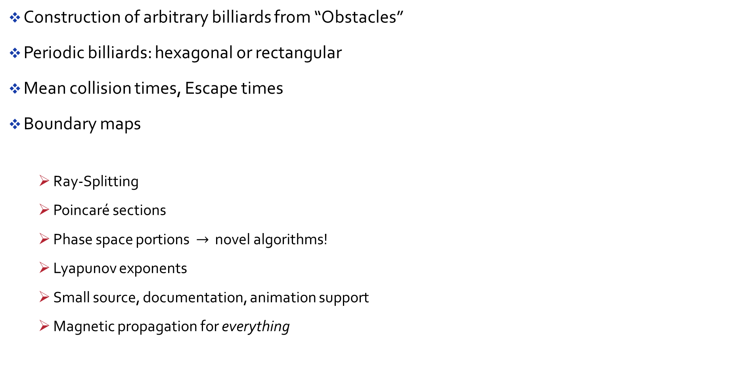
Features of DynamicalBilliards.jl
Construction of arbitrary billiards from “Obstacles”
Periodic billiards: hexagonal or rectangular
Mean collision times, Escape times
Boundary maps
Ray-Splitting
Poincaré sections
Phase space portions $→$ novel algorithms!
Lyapunov exponents
Small source, documentation, animation support
Magnetic propagation for everything
Unique
Notes:
The total lines of code of the source is 2839, while for Bill2D it is 7969.

Slide 12
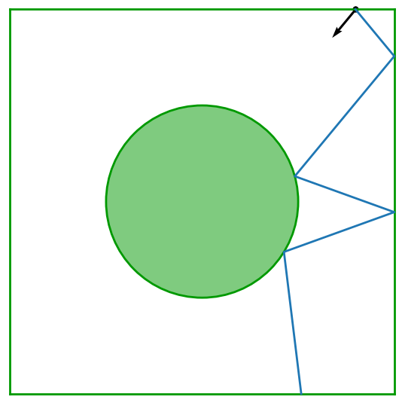
How to simulate a Billiard?
It has to work for any particle in any billiard…
Calculate collision time with all obstacles in the billiard
Find the minimum time and the obstacle it corresponds to
Propagate the particle for this time
Do specular reflection at the boundary of the obstacle
Rinse and repeat!
A function collisiontime is needed…
Affects the design of the entire library
Notes:
I want to find the next obstacle I will collide with. By the way obstacles are the Disks and the Walls. To find the next obstacle I first have to calculate all collision times with all obstacles and then pick the minimum one.
So I need some kind of “function”/”method” to compute the collision time. Should this be a property of the particle? Should this be a property of the obstacle? It doesn’t make sense for it to be either!

Slide 13
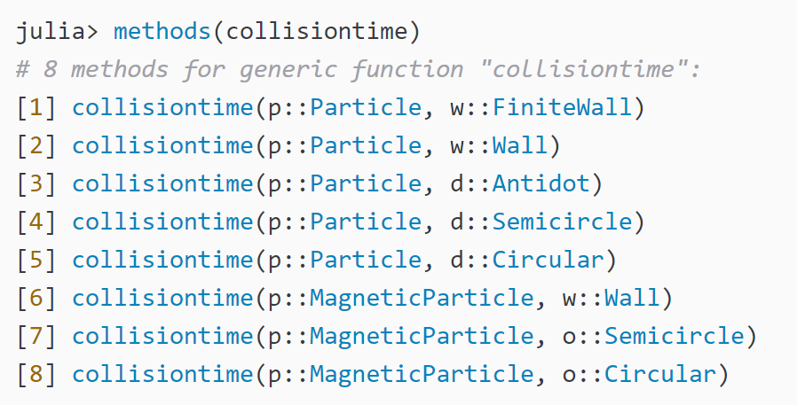
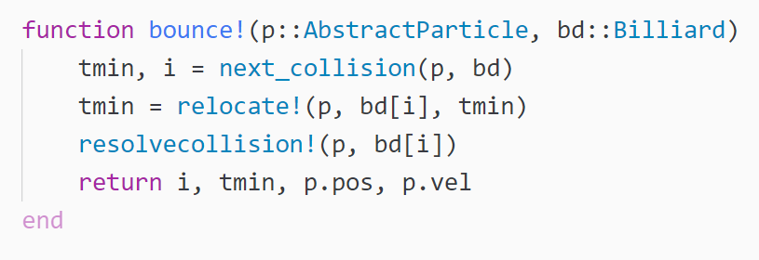
Aspect 1: Clear and intuitive code
Calculate collision time with all obstacles in the billiard
Find the minimum time and the obstacle it corresponds
Propagate the particle for this time
Do specular reflection at the boundary of the obstacle
Rinse and repeat!
Notes:
…the most intuitive way to do it is of course to use multiple dispatch. Julia gives me the possibility to keep everything separated: The particles, the obstacles and the collision times are three different things that multiple dispatch brings together.
It is important for me to stress that I am not hiding the source behind functions! Everything you see here is itself 5 to 10 lines of code.

Slide 14
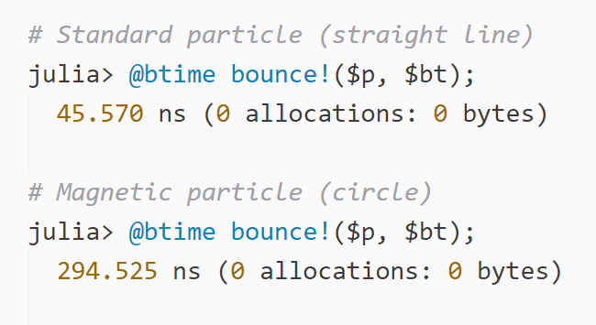
Aspect 2: Performance? No problem.
Sure, source code is small and intuitive…
Is it fast enough though???
Notes:
In a typical application you would want to evolve 1000 particles for 1000 collisions. Such computations would typically take place on computer clusters, but here it runs instantly on my laptop.

Slide 15

DynamicalSystems.jl
DynamicalSystemsBase
ChaosTools
TimeseriesPrediction
Maps & ODEs
All continuous systems use OrdinaryDiffEq
Specialized integrators (function manipulation)
Automatic "completion" of dynamics with ForwardDiff
Delay coordinates reconstruction
Orbit diagrams, Poincaré surfaces of section
Lyapunov exponents
Attractor dimensions
Distinguishing chaos
Fixed points of maps
Estimating reconstruction parameters
Predicting the future of a timeseries using local modelling
Spatio-temporal timeseries prediction & cross-prediction
Winner of the SIAM DSWeb Software Contest
category: grad student
Notes:
Of course, I cannot present everything in this talk. However, there is a long tutorial on the JuliaLang youtube channel…
In this talk I will just focus on Lyapunov Exponents.

Slide 16
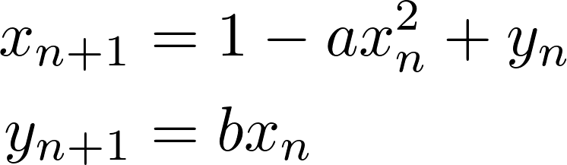
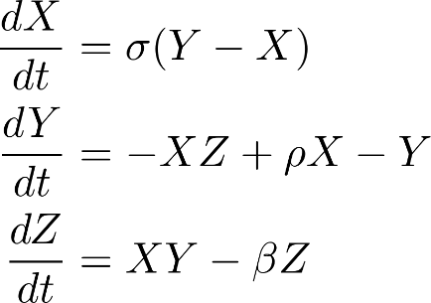
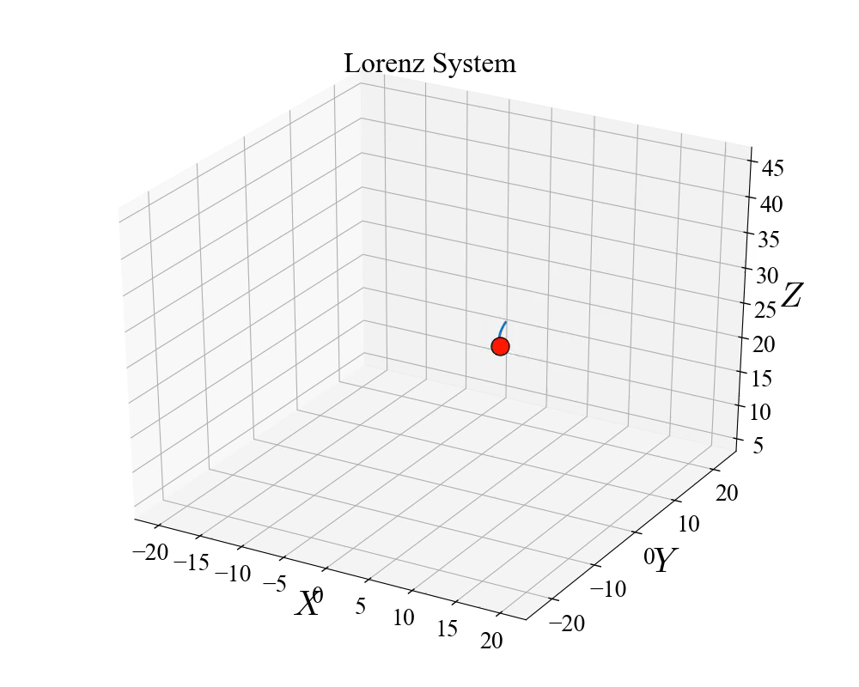
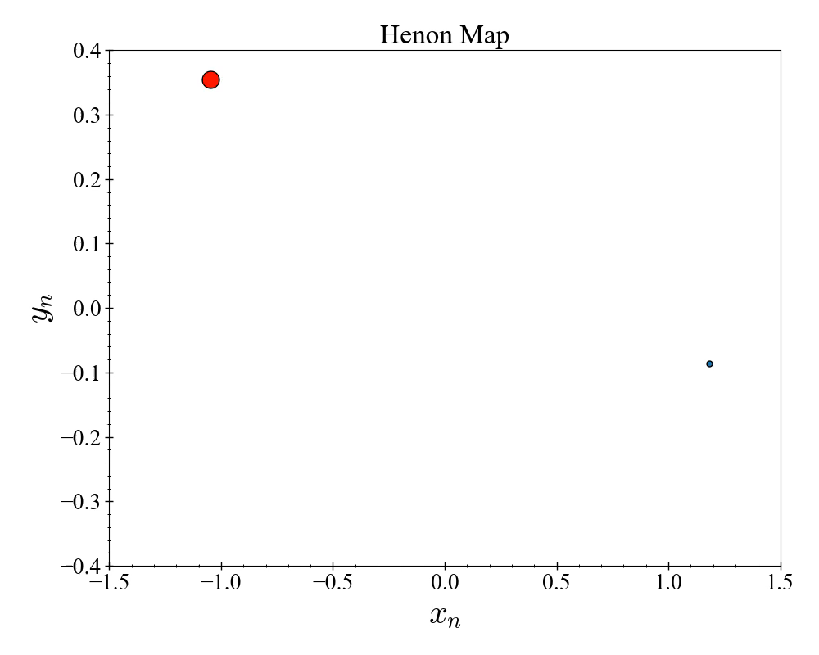
Crash-course: Dynamical Systems
A dynamical system is a rule of how quantities evolve and a state to be evolved
Map: or ODE:

Slide 17
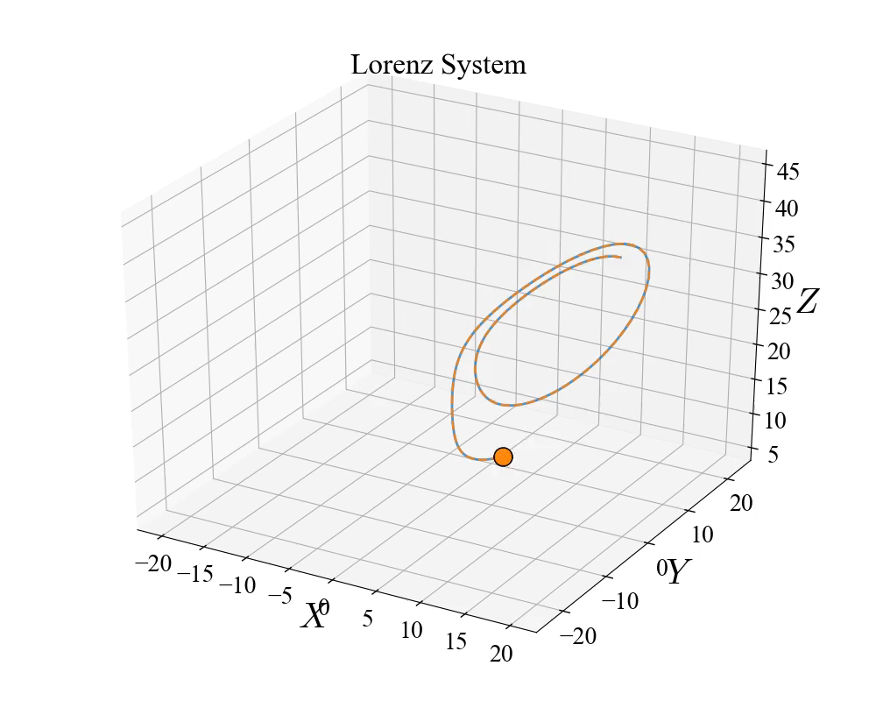
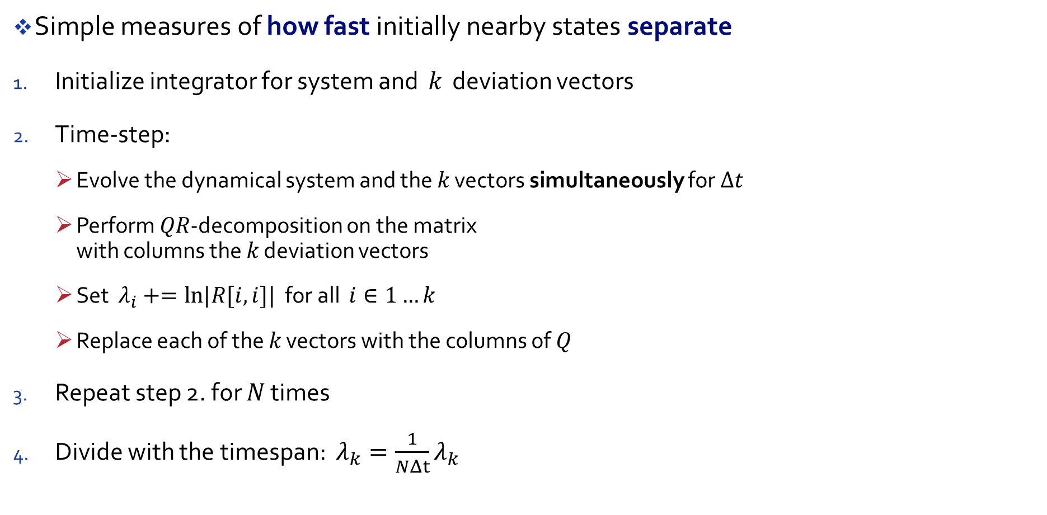
Crash-course: Lyapunov Exponents
Simple measures of how fast initially nearby states separate
Initialize integrator for system and 𝑘 deviation vectors
Time-step:
Evolve the dynamical system and the 𝑘 vectors simultaneously for Δ𝑡
Perform 𝑄𝑅-decomposition on the matrix with columns the 𝑘 deviation vectors
Set $λ_{i}+=ln|R[i,i]|$ for all $i∈1…k$
Replace each of the 𝑘 vectors with the columns of 𝑄
Repeat step 2. for 𝑁 times
Divide with the timespan: $λ_{k}=\frac{1}{NΔt}λ_{k}$
Notes:
In DynamicalSystems.jl we deal with chaotic systems, like for example the weather. In these systems initial conditions that are arbitrarily close begin to separate exponentially. This is also why weather prediction is impossible.
The Lorenz system that I just introduced is such a chaotic weather model. In this figure I have created two initial conditions that are very close and I evolve them in time…

Slide 18
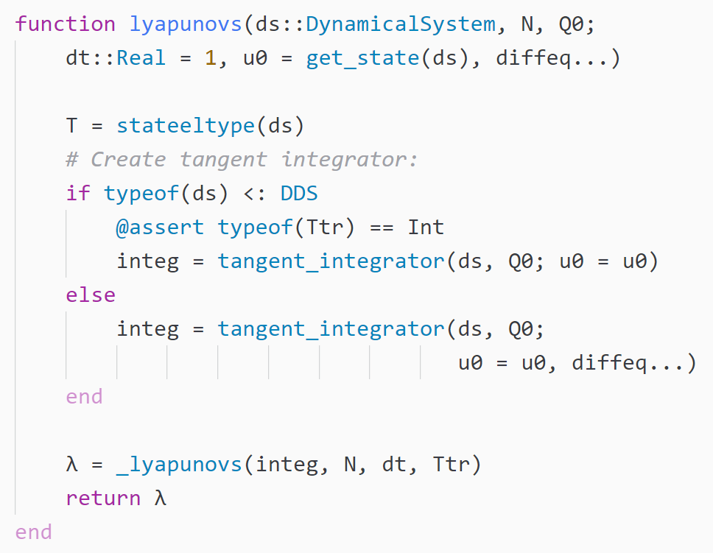
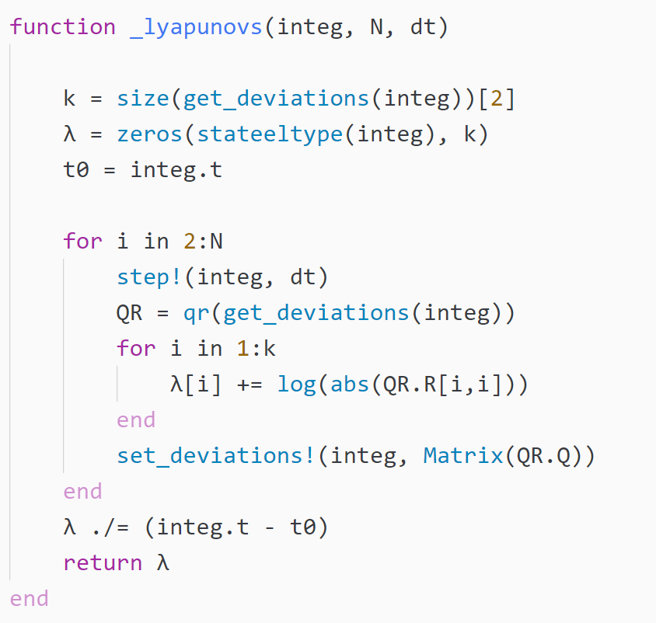
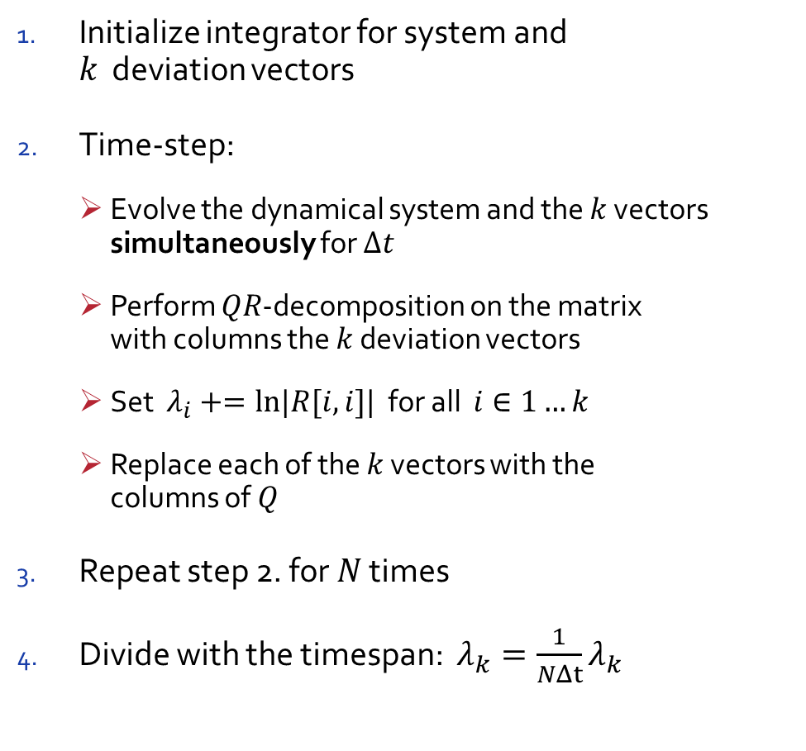
Aspect 3: 1-to-1 code-algorithm
Initialize integrator for system and 𝑘 deviation vectors
Time-step:
Evolve the dynamical system and the 𝑘 vectors simultaneously for Δ𝑡
Perform 𝑄𝑅-decomposition on the matrix with columns the 𝑘 deviation vectors
Set $λ_{i}+=ln|R[i,i]|$ for all $i∈1…k$
Replace each of the 𝑘 vectors with the columns of 𝑄
Repeat step 2. for 𝑁 times
Divide with the timespan: $λ_{k}=\frac{1}{NΔt}λ_{k}$
Notes:
I first want to say that these 30 lines of code you see here are the exact same lines that are called for any system, whether it is discrete or continuous, big or small! Now, the code you see on the left initializes this special integrator that evolves the system and deviation vectors. I will talk about this later so we don’t care for now. CLICK.
What I want to highlight is…. Why do I think this is important? I have taken many nonlinear dynamics courses in my life, and let me tell you: you cannot do nonlinear dynamics without a computer. Yet in all these courses I have never seen computer code being shown. Why ? Well the answer is simple, because code is complicated. I believe Julia can change that.

Slide 19
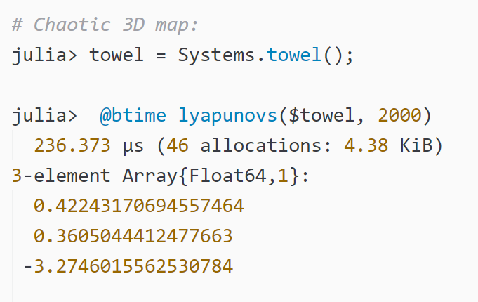
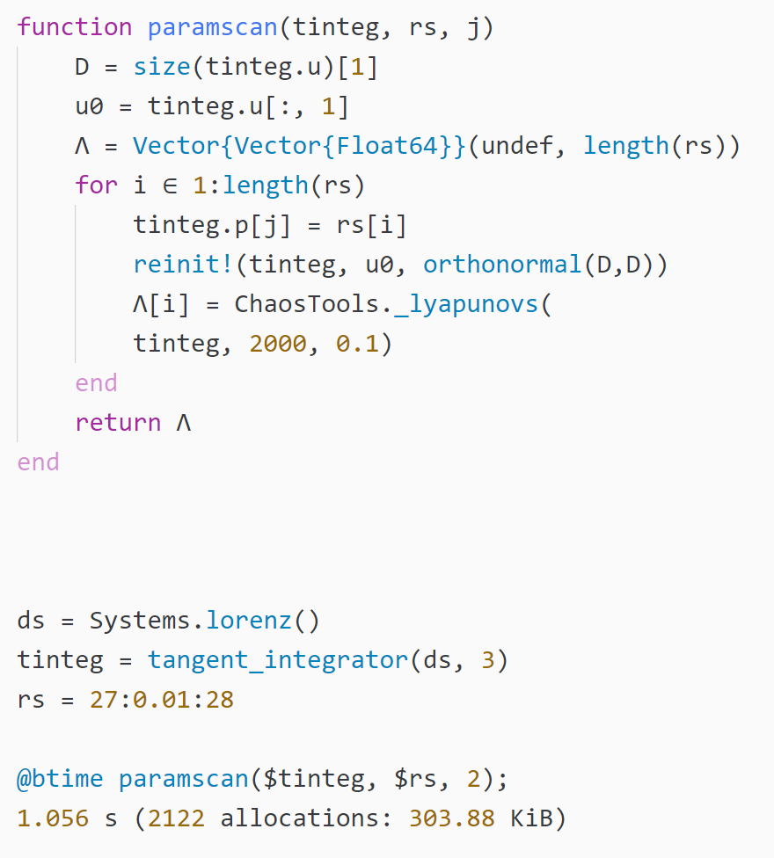
Aspect 4: But is it fast?
Sure, source code is intuitive
Is it fast enough???
Notes:
So typically you would want to do parameter scans and find exponents for let’s say 100 parameters. Once again this computation will take at most a second!

Slide 20
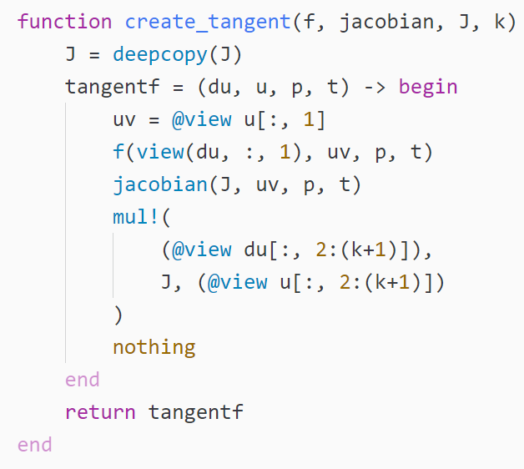
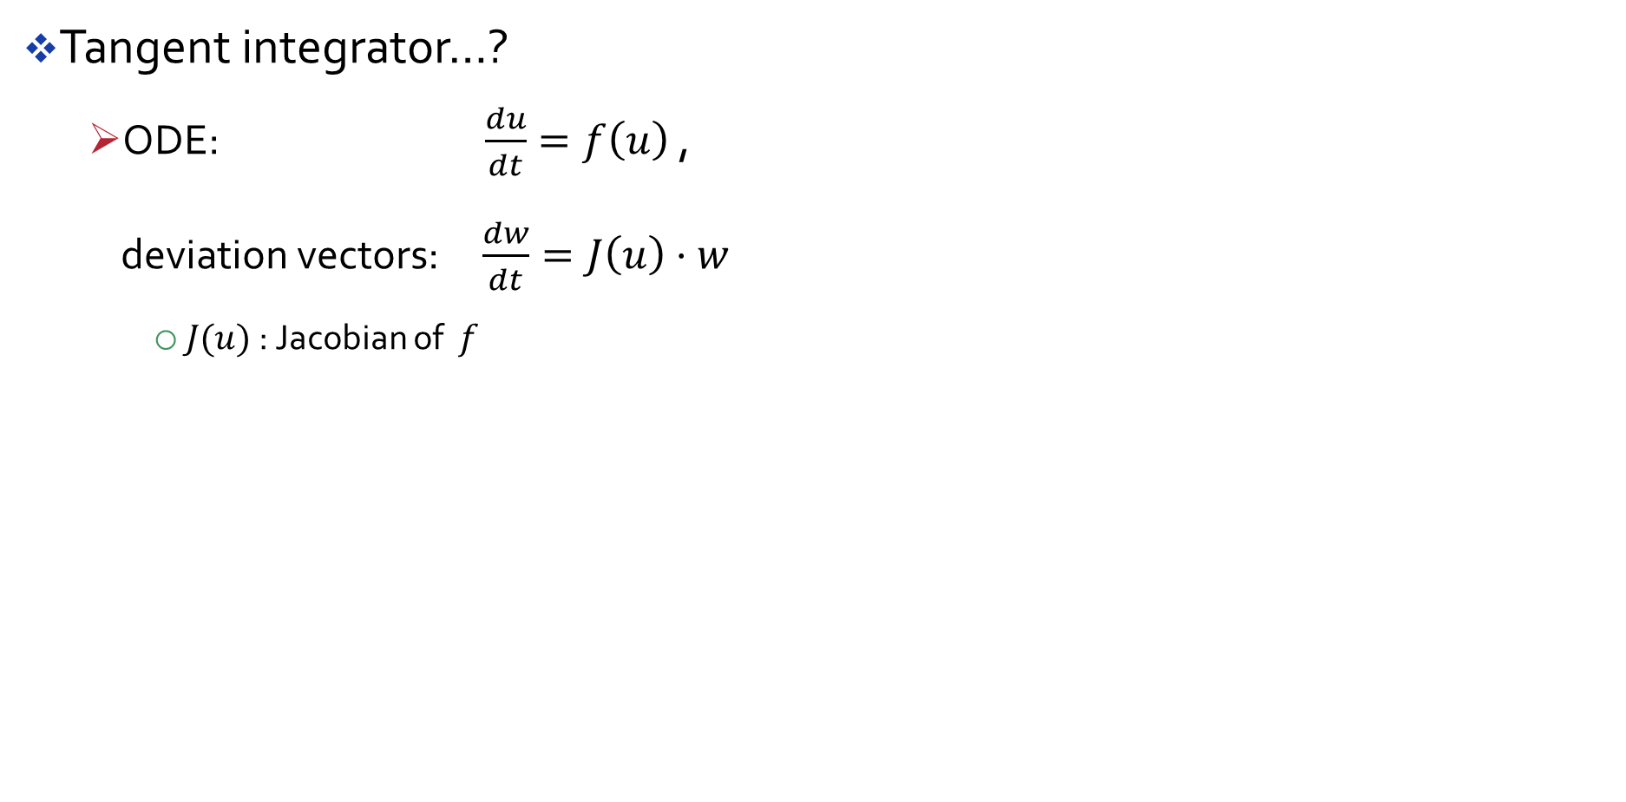
Aspect 5: manipulating functions
Tangent integrator…?
ODE: $\frac{du}{dt}=f\left(u\right)$ , deviation vectors: $\frac{dw}{dt}=J\left(u\right)⋅w$
$J(u)$ : Jacobian of $f$
Notes:
To do this in DifferentialEquations.jl, we manipulate functions as objects
You must have a single equations of motion function
It has to evolve both the normal system and the deviation vectors
Notice that the first two arguments of the function `create_tangent` are functions themselves. Then, inside the body, we create a new function that uses these two functions.

Slide 21
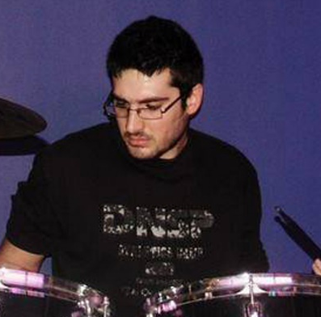
Summary
Julia has made my own workflow (as a scientist) massively more productive
Can apply to many more scientists
JuliaDynamics: check us out!
P.s.: JuliaMusic incoming
Gitter/Slack: @Datseris

Slide 22





Thank you!
Jonas Isensee
Lukas Hupe
Chris Rackauckas
@jrevels
@KristofferC
@JoelHobson
@dpsanders
@pfitzeb
@ScottPJones
@andyferris
@dapias
@tkf
@RainerEngelken
@halleysfifthinc
@pkofod
And from my Institute:
Ragnar Fleischman
Ulrich Parlitz
Notes:
Thank all the people that tolerate me while I am trying to convince them to use Julia

